Slide 1
Restricted DCJ Model: Rearrangement Problems with Chromosome Reincorporation
JAKUB KOVÁĆ, ROBERT WARREN, MARÍLIA D.V. BRAGA and JENS STOYE
JOURNAL OF COMPUTATIONAL BIOLOGY, 2011
Ron Zeira
Group meeting 12.6.13

Slide 2
Outline
Motivation
DCJ model and solution
Restricted DCJ model
Restricted DCJ sorting
DCJ halving problem
Restricted DCJ halving
Restricted DCJ median

Slide 3
Motivation
During evolution, genomes undergo large-scale mutation:
Reversals
Translocations
Chromosome fusion
Chromosome fission
Block interchanges
Duplications
Deletions

Slide 4
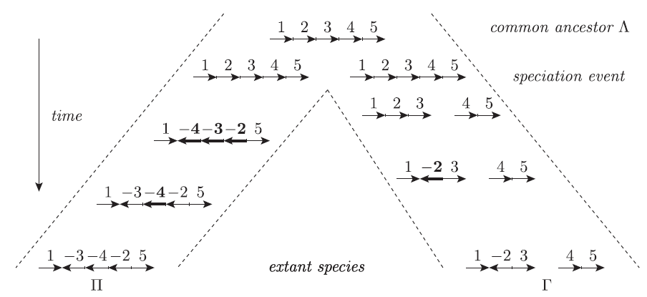
Motivation
Reversal
Block interchange
Fission

Slide 5
DCJ model
Yancopoulos et al. 2005.
A unifying view of genome rearrangements.
Anne Bergeron, Julia Mixtacki, and Jens Stoye.
Given 2 genomes A and B (no duplications), find a shortest sequence of rearrangement operations that transforms A into B.

Slide 6
Definitions
Gene – oriented DNA sequence from tail (5’) and to head (3’).
For gene a: a_{t} - tail and a_{h} - head.
adjacency of 2 consecutive genes a and b, depends on their orientation:
Extremity that is not adjacent to any other gene is called a telomere, represented by a singleton set : {a_{t}} or {a_{h}}.

Slide 7
Definitions
A genome is a set of adjacencies and telomeres such that the tail or the head of any gene appears in exactly one adjacency or telomere.
Chromosomes are either linear (bounded by two telomeres) or circular (no telomere).

Slide 8
Genome example

Slide 9
DCJ operation
A: {p,q},{r,s} → {p,r},{q,s} or {p,s},{q,r}
B: {p,q},{r} → {p,r},{q} or {q,r},{p}
C1: {r},{q} → {r,q},({})
C2: {r,q},({}) → {r},{q}
fusion
fission
translocations
translocations

Slide 10
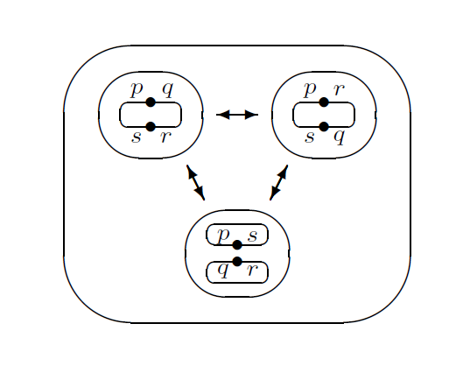
DCJ operation
inversion
inversion
inversion
circular excision
circular excision
circular excision
inversion
circular excision

Slide 11
DCJ distance example
A= ○ ac-d ○ , eb , ○ fg ○
B= ab , ○ cd ○, ○ e ○ , fg

Slide 12
Adjacency graph
Notes:
Obviously, every vertex in the adjacency graph has degree one or two, therefore
it is a union of cycles and paths. Since the graph is bipartite, all cycles have
even length

Slide 13
DCJ distance
Notes:
Lemma 1. The application of a single DCJ operation changes the number of
circular or linear components by at most one.
Lemma 2. Let A and B be two genomes defined on the same set of N genes,
then we have
A = B if and only if N = C + I/2
where C is the number of cycles and I the number of odd paths in AG(A,B).
Lemma 3. The application of a single DCJ operation changes the number of
odd paths in the adjacency graph by –2, 0, or 2.
Lemma 4. Let A and B be two genomes defined on the same set of N genes,
then we have
dDCJ (A,B) N − (C + I/2)
where C is the number of cycles and I the number of odd paths in AG(A,B).

Slide 14
Restricted DCJ model
Genomes with multiple linear chromosomes
Each circular excision immediately followed by its incorporation
Effectively, block interchange operation in 2 DCJs operations

Slide 15
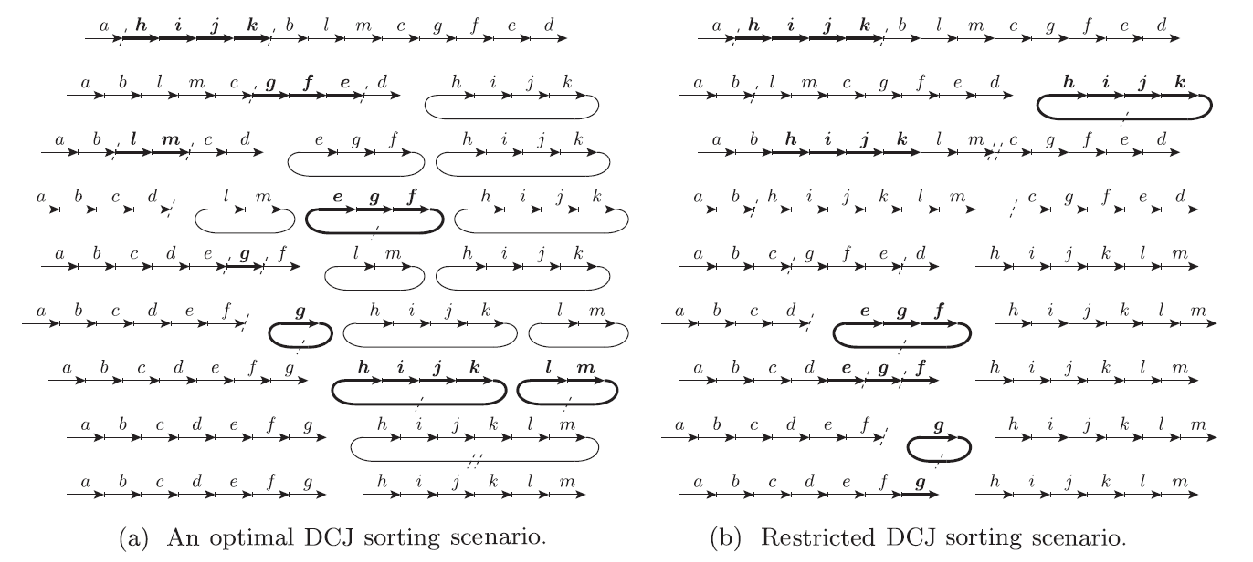
Restricted DCJ example

Slide 16
Restricted DCJ sorting
THEOREM. Multilinear genomes Π, Γ: d_{DCJ}(Π,Γ)=d_{restricted-DCJ}(Π, Γ)
Scenario in O(n*log(n))
Algorithm outline:
Capping
“left to right” extend chromosomes iteratively:
Optimal DCJ ←→increases C by 1 xor OP by 2

Slide 17
Capping
Adjoin new markers (caps) to telomere ends
Odd paths:
Even paths:
Distance unchanged
Only cycles and 1-paths
y○
y◊
◊○
○x
x◊
◊○
○x
y○
x◊
y∆
○◊
∆○
∆◊
○◊
∆○

Slide 18
Iterative building
j,j+1 already properly adjacent → Done
j, j+1 on different chromosomes:
O.W. → j,j+1 on same chromosome
j,j+1 reverse orientation:
O.W. →j,j+1 same orientation
or

Slide 19
Iterative building
m+1 on different chromosome:
O.W. → m+1 same chromosome
m+1 reverse orientation

Slide 20
Iterative building
m,m+1 same orientation
or

Slide 21
Data structure
DS for permutations – Kaplan & Verbin (2005)
Balanced tree + additional information (marker, size, orientation flag, reverse flag, chromosome delimiters)
Logarithmic time operations:
Find i^{th} marker of a chromosome
Find position of marker g
Reverse operation
Mimic DCJ using reversals

Slide 22
DCJ halving problem
Warren-Sankoff 2008, Mixtacki 2009
2 paralogous copies per marker
Perfectly duplicated genome A:
Alternative definition:
Linear chromosome C_{i} :
Circular chromosome C_{i} :

Slide 23
DCJ halving problem
Perfectly duplicated genome example:
Given Π, a duplicated genome, find a perfectly duplicated genome with minimal DCJ distance

Slide 24
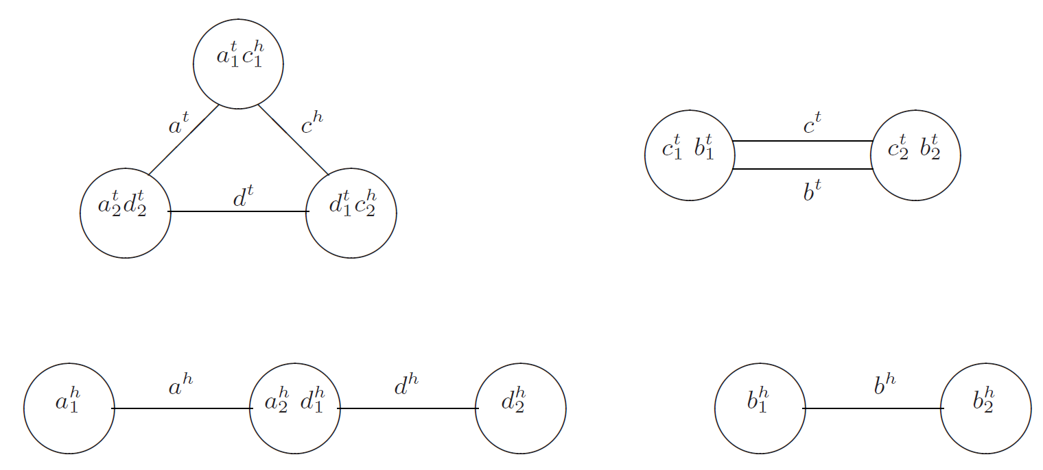
Natural graph

Slide 25
DCJ having distance
DCJ halving distance:
EC – even cycles, OP – odd paths
Min distance perfectly duplicated genome in O(n)

Slide 26
Restricted DCJ halving
Find a multilinear perfectly duplicated genome with min distance
Find unrestricted DCJ halving genome
Transform to multilinear while preserving distance
Particular scenario in O(n*log(n))

Slide 27
Restricted DCJ halving
Let: Π – original genome, Φ- unrestricted perfectly duplicated genome
Add paralogous caps
Integrating adjacency {x,y} in Π iff x in linear chro. and y in circular chro. in Φ
If {x,p},{y,q} in Φ, replace:

Slide 28
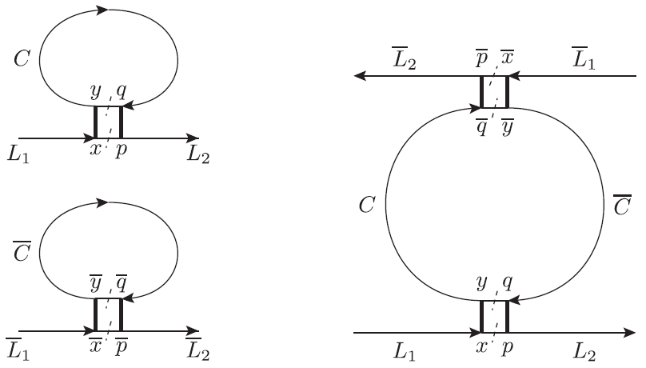
Integrating adjacency

Slide 29
Integrating adjacency
Preserving distance
Still perfectly duplicated genome
Linear time

Slide 30
DCJ median problem
Reconstruct common ancestor of Π, Γ
Distance is not enough
Add outgroup specy Φ
Find a median M with minimal distance:
M
Π
Γ
Φ

Slide 31
Restricted DCJ median
DCJ median for unilinear chro. is NP-hard – Caprara 2003
Let Π₁, Π₂, Π₃ unilinear chro., Π_{M} multilinear chro. median genome
Fuse Π_{M} telomeres into single chro. Π’_{M}
2 linear chro. can be joined in 4 ways
In AG(Π_{i},Π_{M}) at most 2 odd paths

Slide 32
Restricted DCJ median
Telomeres in different even paths → ∆d=0
Telomeres in same even path → ∆d=-1
Telomeres in different odd paths → ∆d=+1
Case 3 can happen once
Can always fuse linear chro. and improve distance

Slide 33
Summary
Restricted DCJ model is more realistic
Adds block exchange operation
Distance is the same as unrestricted
da Silva et al. 2012 added indel to model

